Slide 1
END to END Pipeline For Code Analysis and Generation

Slide 2


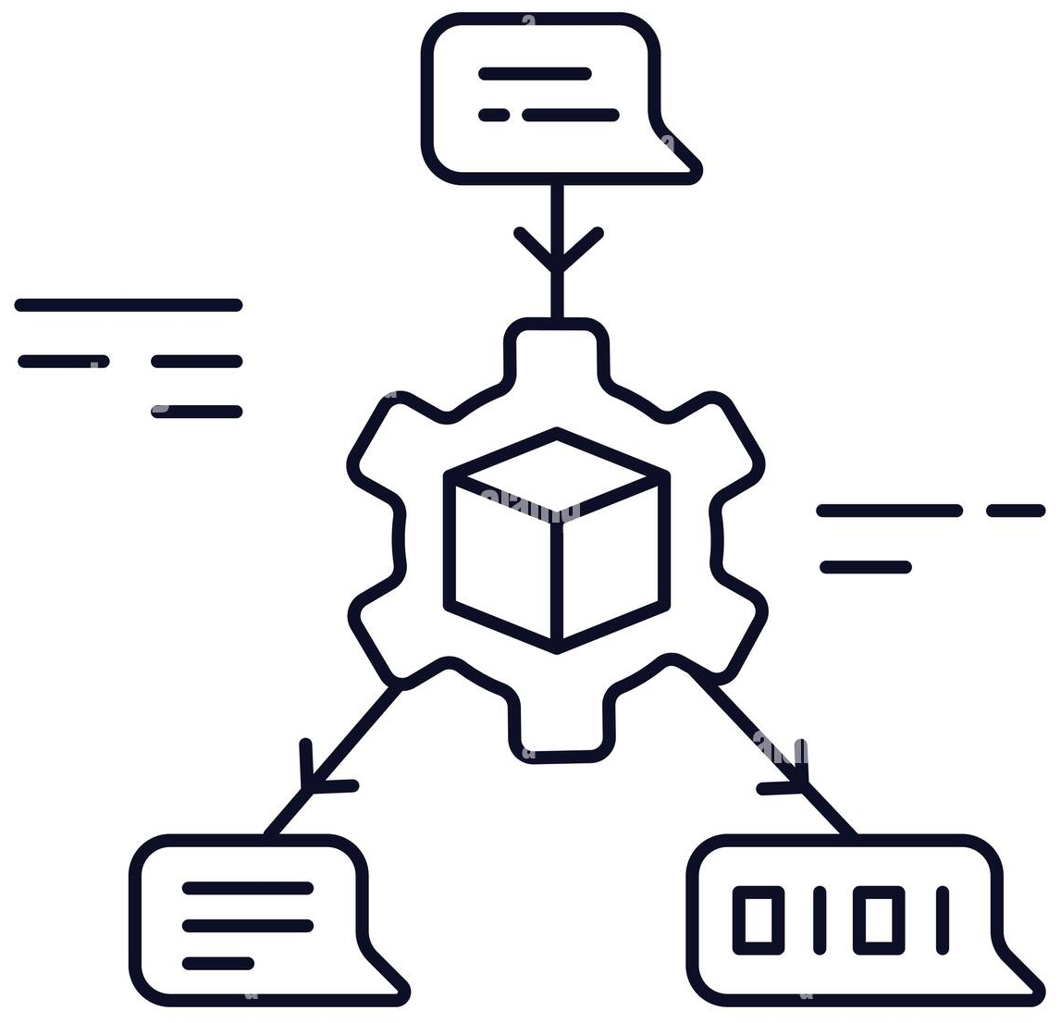







Pipeline For Auto Exaction
Static Analyzer
RAG System
Package
Go
C
Python
C++
Java
For Each File
Lines of code
No of functions
No of Classes/Types
Complexity
For Each Folder
No of Files
Lines of code
No of functions
No of Classes/Types
For Package
No of Files
Lines of code
No of functions
No of Classes/Types
Private
Vector
Database
Debug
Vector
Database
Extract Source Files from folder
Save Analysis Results
Quaery/Response
Deep Analyzer
Execution Envoironment
Gen AI Summarizer
For Each Source File
Pass errors to Summarizer
Search Summary in RAG for Fix
Classes
Classes
If Errors
Build sourec file
Self Reflection
If fix found
Functions
Functions
Structs
Structs
Save Fix
Pass the Negative feedback
Pass the positive feedback
Unions
Unions
Save Build Command
Update short/long term memory
Entities Which Curruntly Defined in File
Find Line Numbers where its defined
Find source file path
Entities Which Externally Defined in File
Find Out Nested Dependancy
Find Out Nested Dependancy
Find Line Numbers where its defined
Create Structured Representation
Create Structured Representation
Constants
Create Build Command
Constants
Resolve Dependancy
Typedefs
Typedefs
Manual Debugeer
Update Build Command
Gen AI Debugger
Variables
Variables
Enums
Enums
If Selfreflection Excced
is feedback +/-
Pass Execution Env
Save Build command
Ask Mannual fix for error
Update short/long term memory
Macros
Save Fix
Build Source File
Macros
Save Representation & Analysis
Genarte Fix & Update Build Command

Slide 3
Pipeline For Auto Code Conversion
Static Analyzer
RAG System
Package
Save Analysis Results
Go
C
Python
C++
Java
Private
Vector
Database
Debug
Vector
Database
Execution Environment
Gen AI Summarizer
Extract Source Files from folder
Pass errors to Summarizer
Search Summary in RAG for Fix
If Errors
Quaery/Response
Build sourec file
Self Reflection
If fix found
Save Fix
Pass the Negative feedback
Pass the positive feedback
Call Execution environment
Deep Analyzer
Save Build Command
Update short/long term memory
For Each Source File
Manual Debugeer
Update Build Command
Gen AI Debugger
Pass results for similarity analysis
Inline
code with reference
is feedback +/-
Pass Execution Env
Yes
Save Build command
If Selfreflection Excced
Update short/long term memory
Ask Mannual fix for error
Save Fix
Build Source File
Get reference Source, Explanation & Summary, [Negative Summary and source]
Entities Which Curruntly Defined in File
Entities Which Externally Defined in File
Genarte Fix & Update Build Command
Create Build Command
Resolve Dependancy
If source is not similar
Code Explanator
Code Converter
Manuual Code Inlinement
Similarity
Estimator
Classes
Get Refference file
Functions
If execution succed
Get summary for each entity in refernce and converted
Structs
Save explanations
Save coverted Source
Yes
Generate Summary
Unions
Estimate similarity
Get Source File
Pass results for analysis
Get Source File
Constants
Ask Mannual fix for error
Save Fix
Build Source File
Typedefs
If Selfreflection Excced
Save Build command
Get Converted file
Variables
Enums
Save Representation & Analysis
Macros
Update short/long term memory
Update short/long term memory
Update short/long term memory

Slide 4
Pipeline For Auto Unit Test Case Generation
Execution Envoironment Source
Gen AI Summarizer
RAG System
Package
Pass errors to Summarizer
Go
C
Python
C++
Java
Private
Vector
Database
Debug
Vector
Database
If Errors
Search Summary in RAG for Fix
Static Analyzer
If fix found
Extract Source Files from folder
Build sourec file
Self Reflection
Save Analysis Results
Save Fix
Pass the Negative feedback
Pass the positive feedback
Save Build Command
Update short/long term memory
Manual Debugeer
Update Build Command
Gen AI Debugger
Quaery/Response
is feedback +/-
Pass Execution Env
Save Build command
If Selfreflection Excced
Update short/long term memory
Ask Mannual fix for error
Save Fix
Build Source File
Deep Analyzer
Genarte Fix & Update Build Command
If execution succed
Save explanations
For Each Source File
Get Source File
Execution Envoironment Testcases
Gen AI Summarizer
Pass errors to Summarizer
Search Summary in RAG for Fix
Update short/long term memory
If Errors
Entities Which Curruntly Defined in File
Entities Which Externally Defined in File
Build sourec file
Self Reflection
If fix found
Create Build Command
Save Fix
Pass the Negative feedback
Pass the positive feedback
Resolve Dependancy
Get Source File
Save Generated Testcases
Save Build Command
Update short/long term memory
Pass results for Execution
Manual Debugeer
Update Build Command
Gen AI Debugger
Update short/long term memory
is feedback +/-
Pass Execution Env
Save Build command
If Selfreflection Excced
Update short/long term memory
Create
Coverage
Report
Ask Mannual fix for error
Save Fix
Build Source File
If execution succed
Save Representation & Analysis
Genarte Fix & Update Build Command

